Slide 1
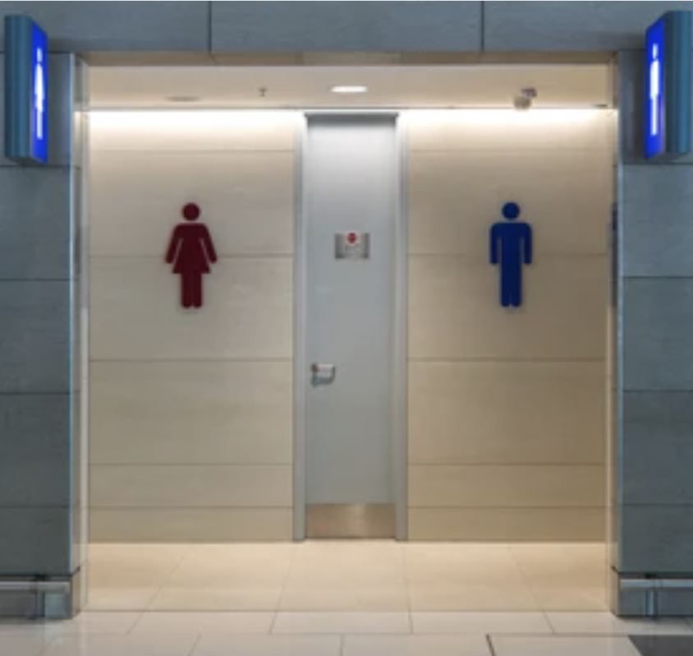
HYGIENIC COUNTRY
Hack N Win Project
Be Clean And Healthy, And A Happy Citizen!

Slide 2
THEME : To Make Our Country Hygienic And clean
MOTIVE : To Create Awareness Among Peoples To Make Our Country Hygienic And Clean.

Slide 3
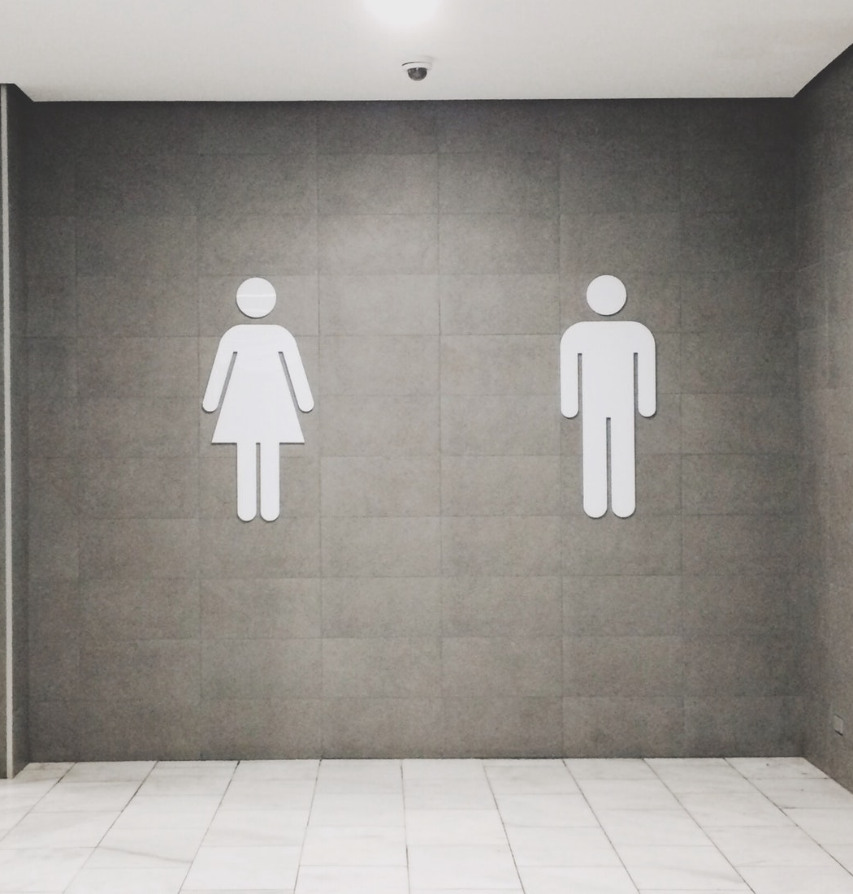
01
WASHROOM LOCATOR
This Will Helps You To Locate Restrooms Which Is Nearest To You

Slide 4
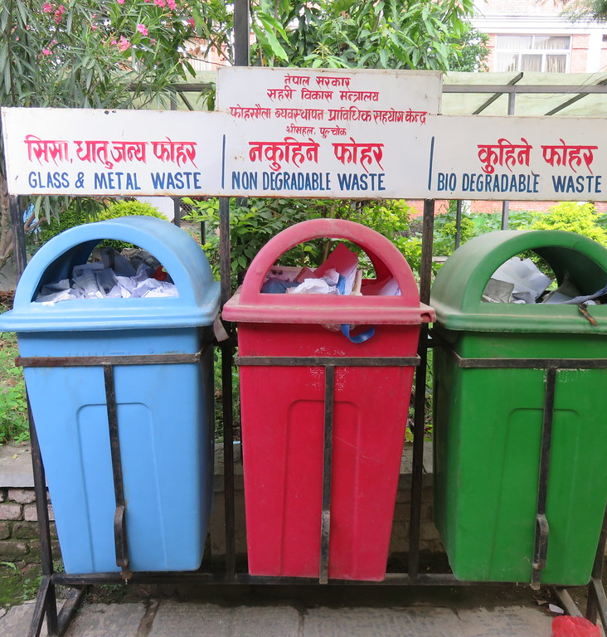
02 GARBAGE REPORTING
This Will Helps You To Locate Dustbins Nearby To You And To Create Awareness Among Peoples.

Slide 5
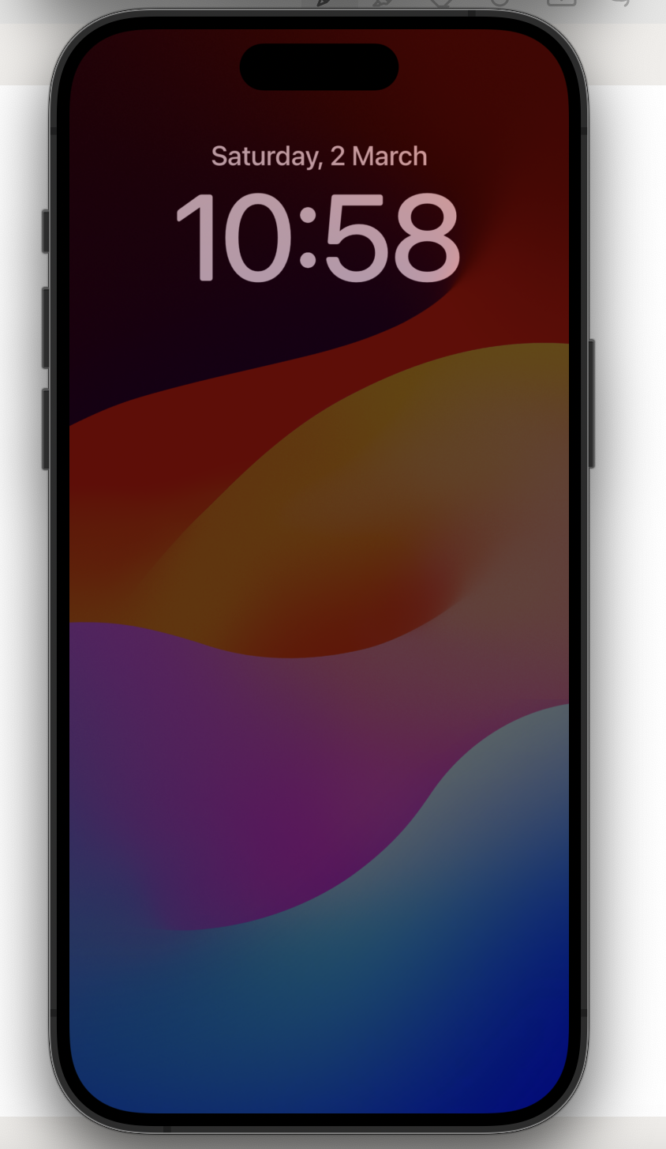
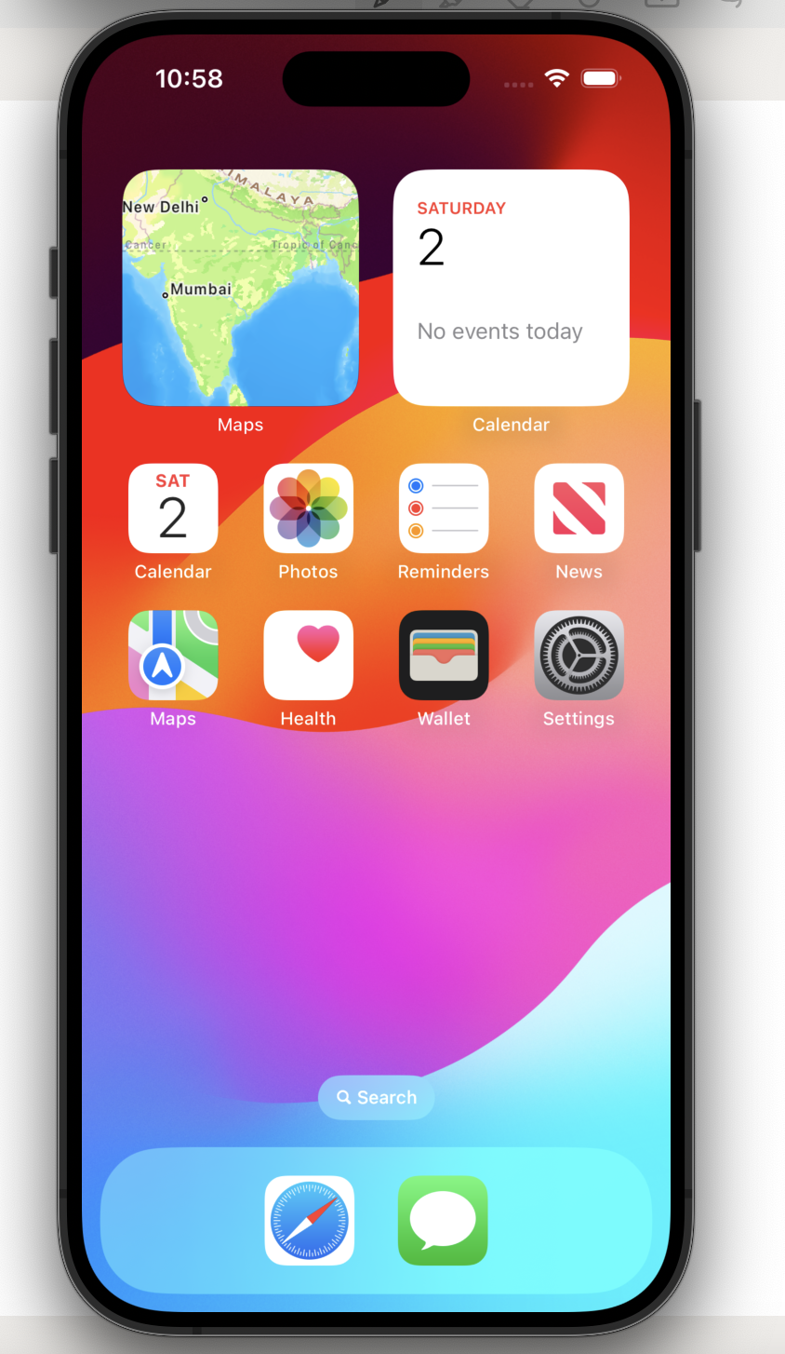
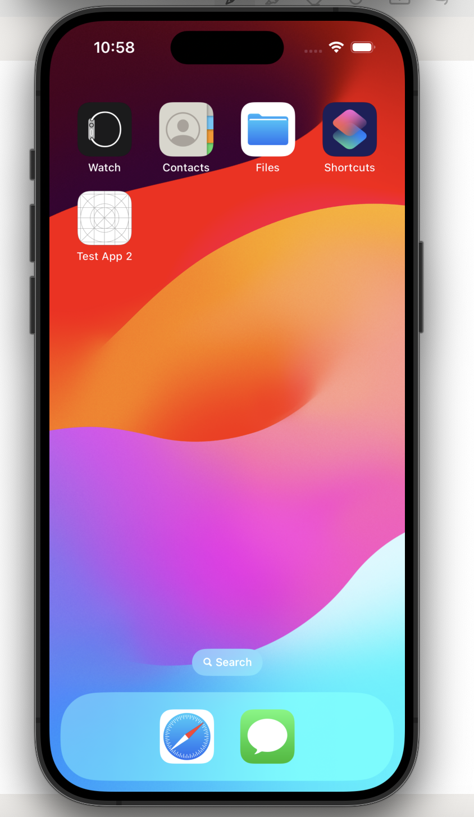
APPLICATION INTERFACE :

Slide 6
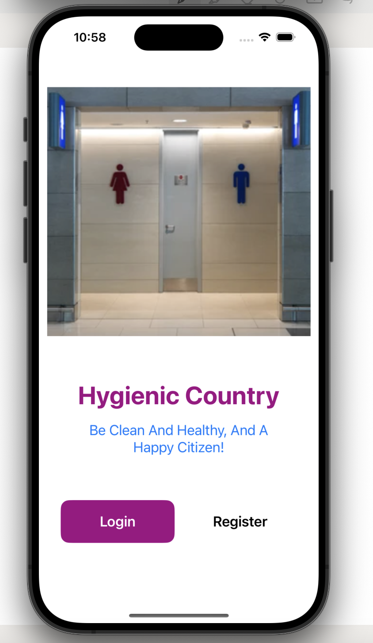
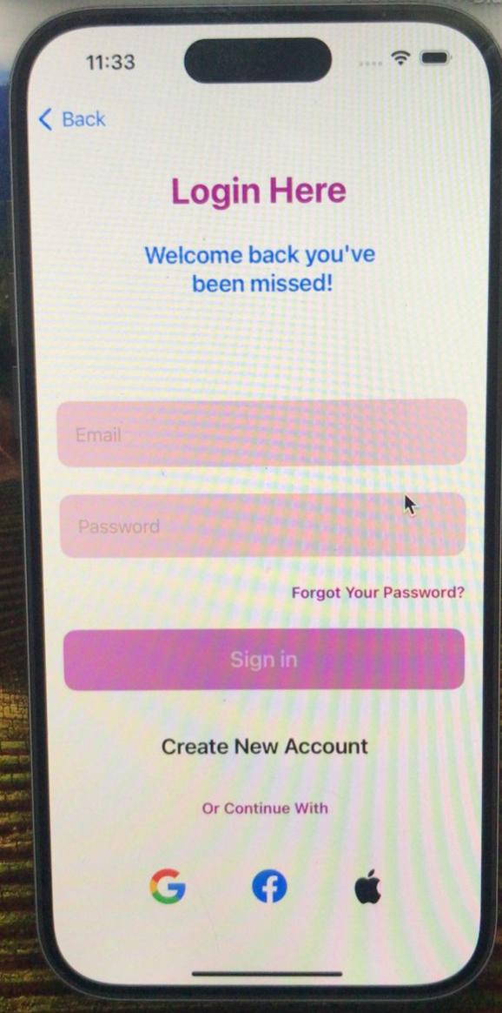
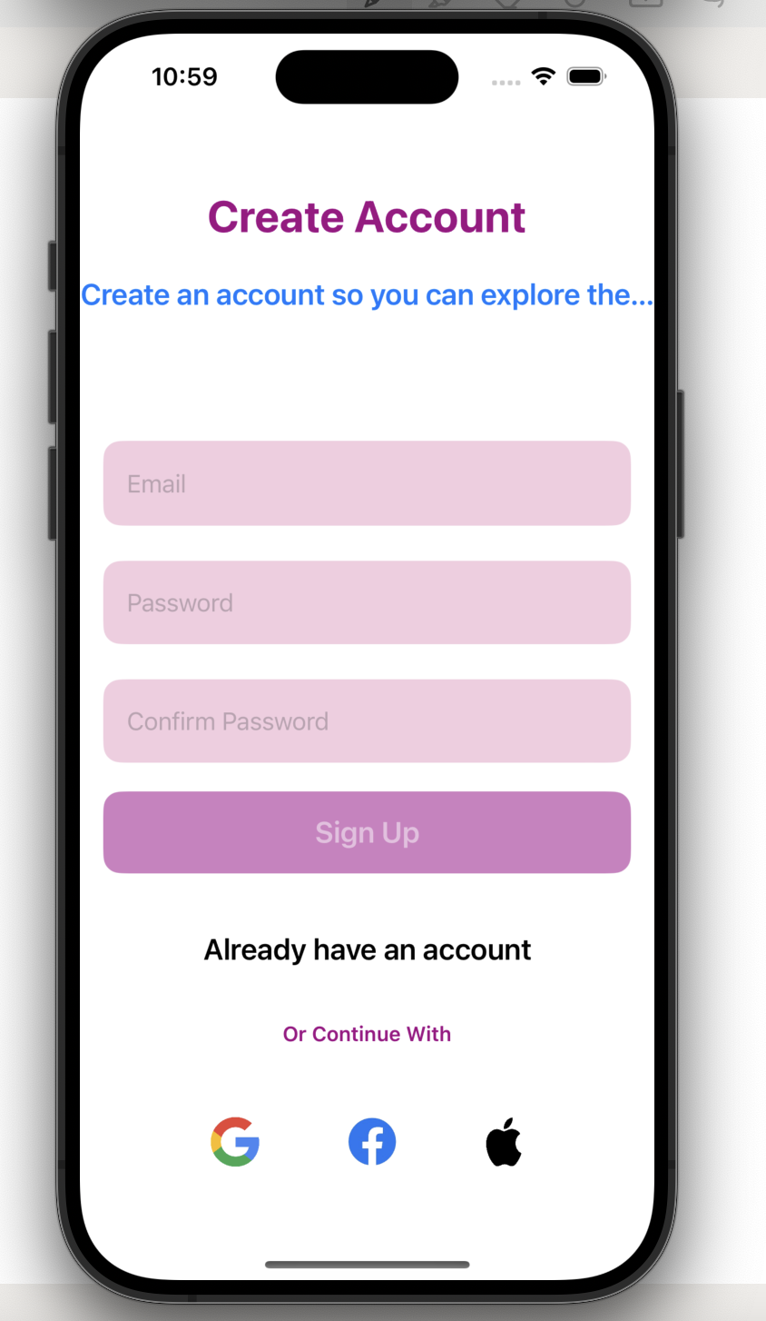

Slide 7
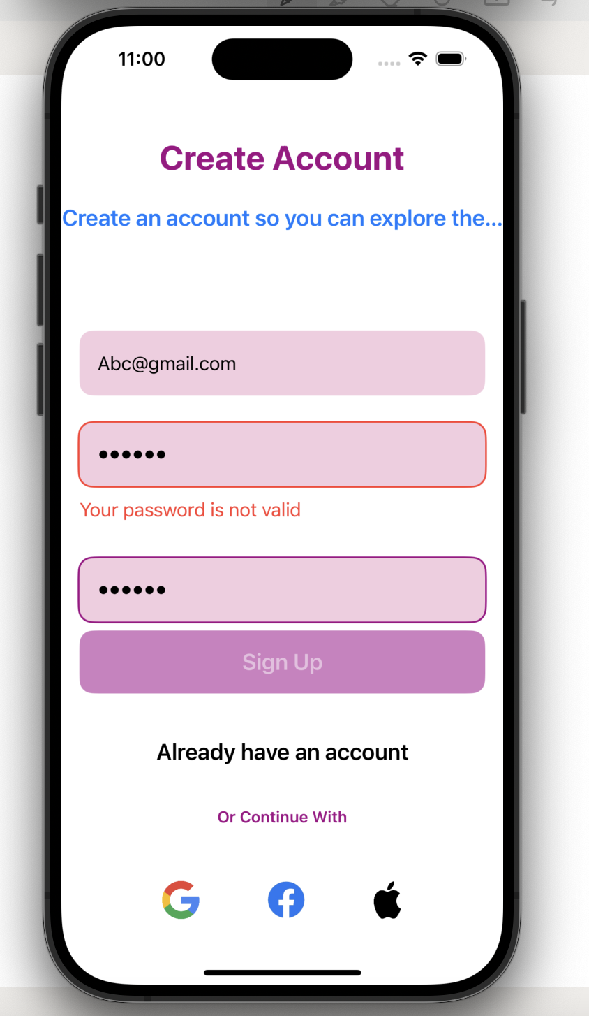
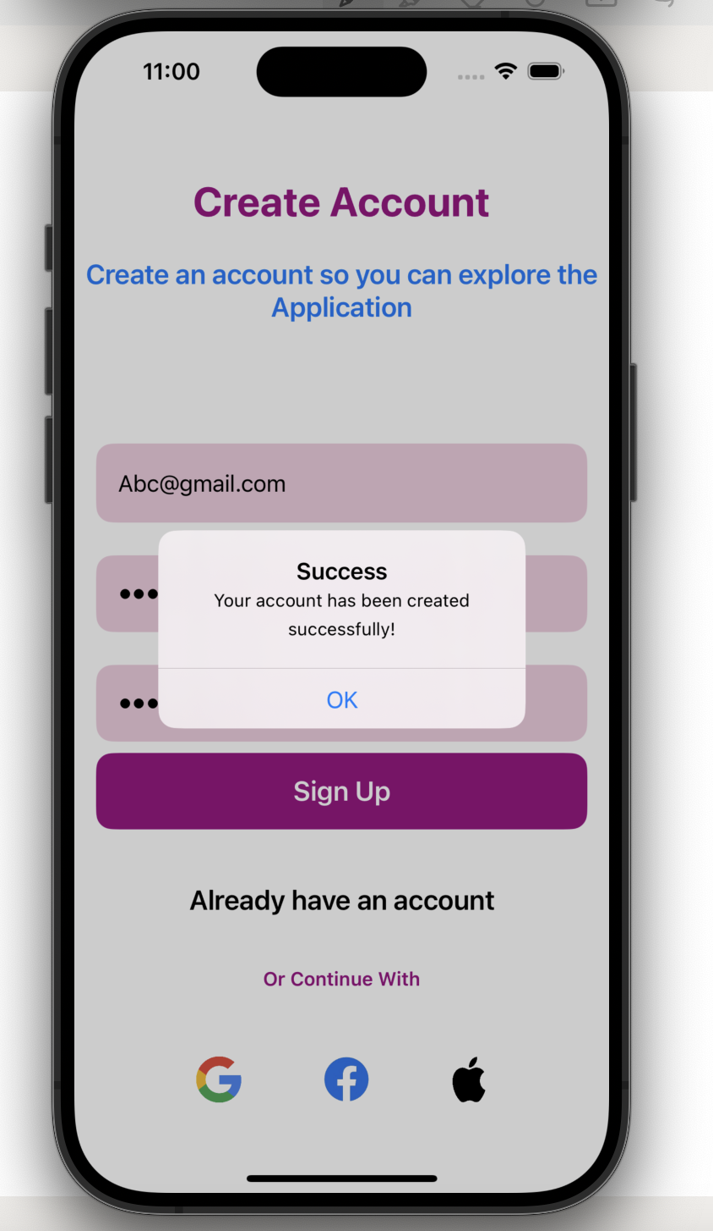

Slide 8
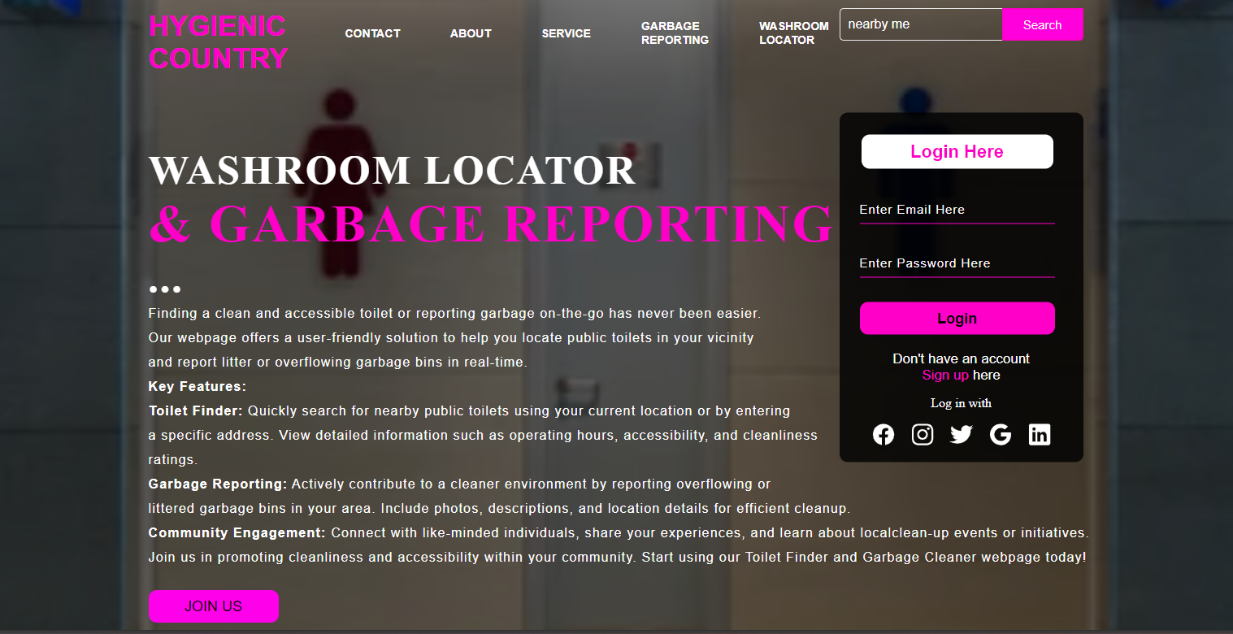

WEBSITE INTERFACE :

Slide 9

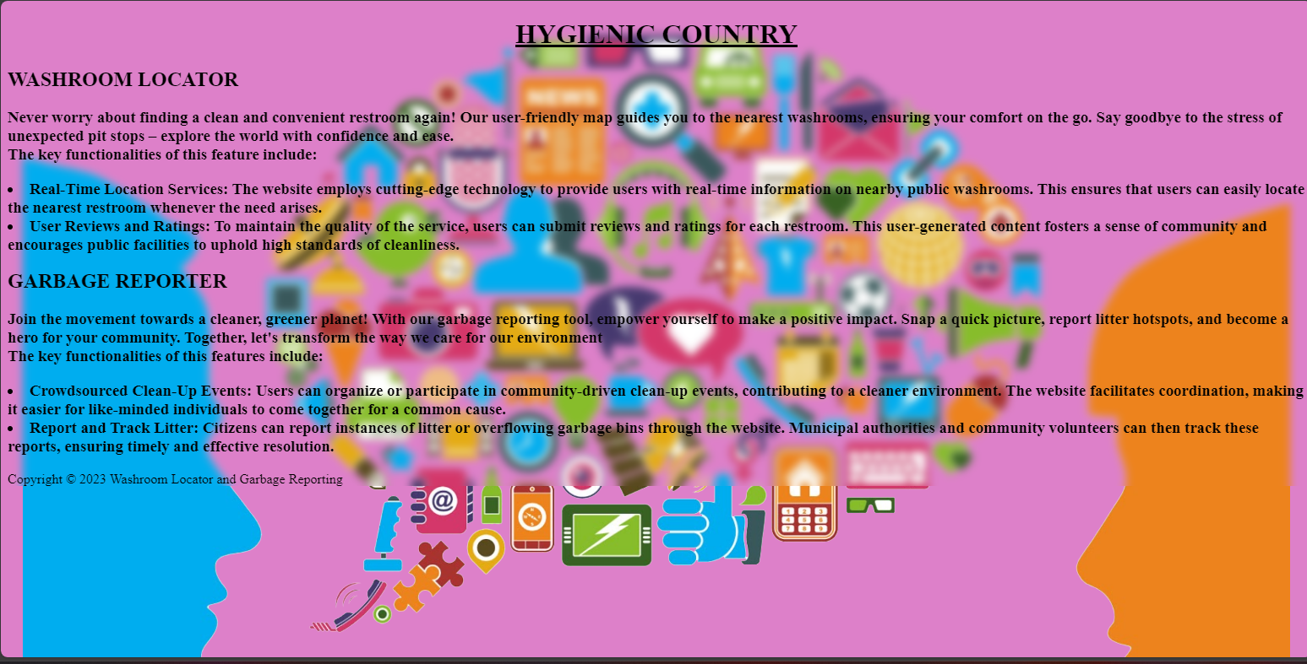
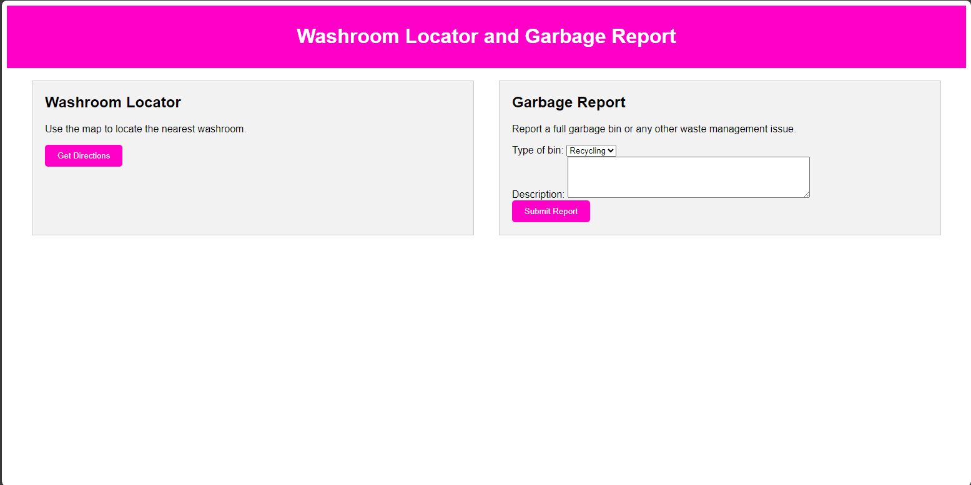

Slide 10
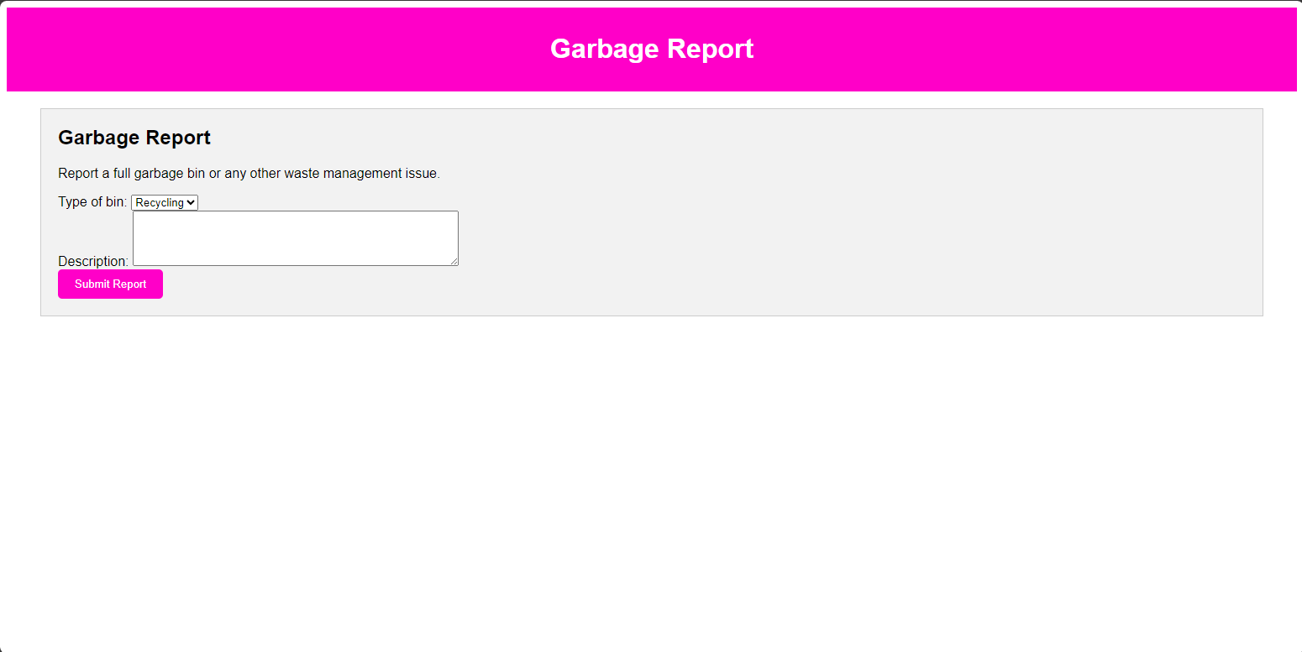
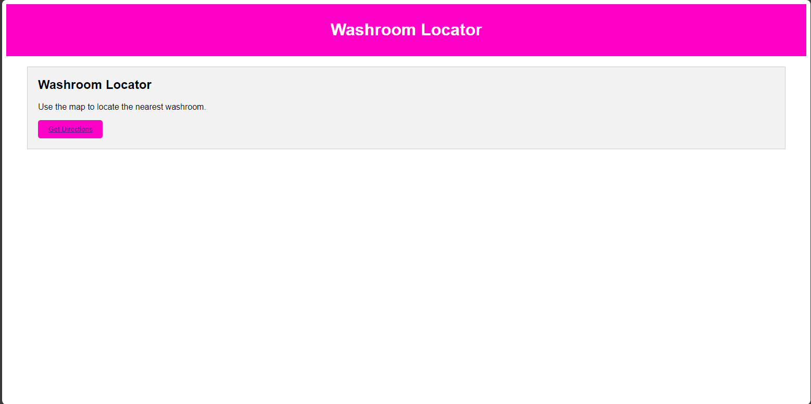
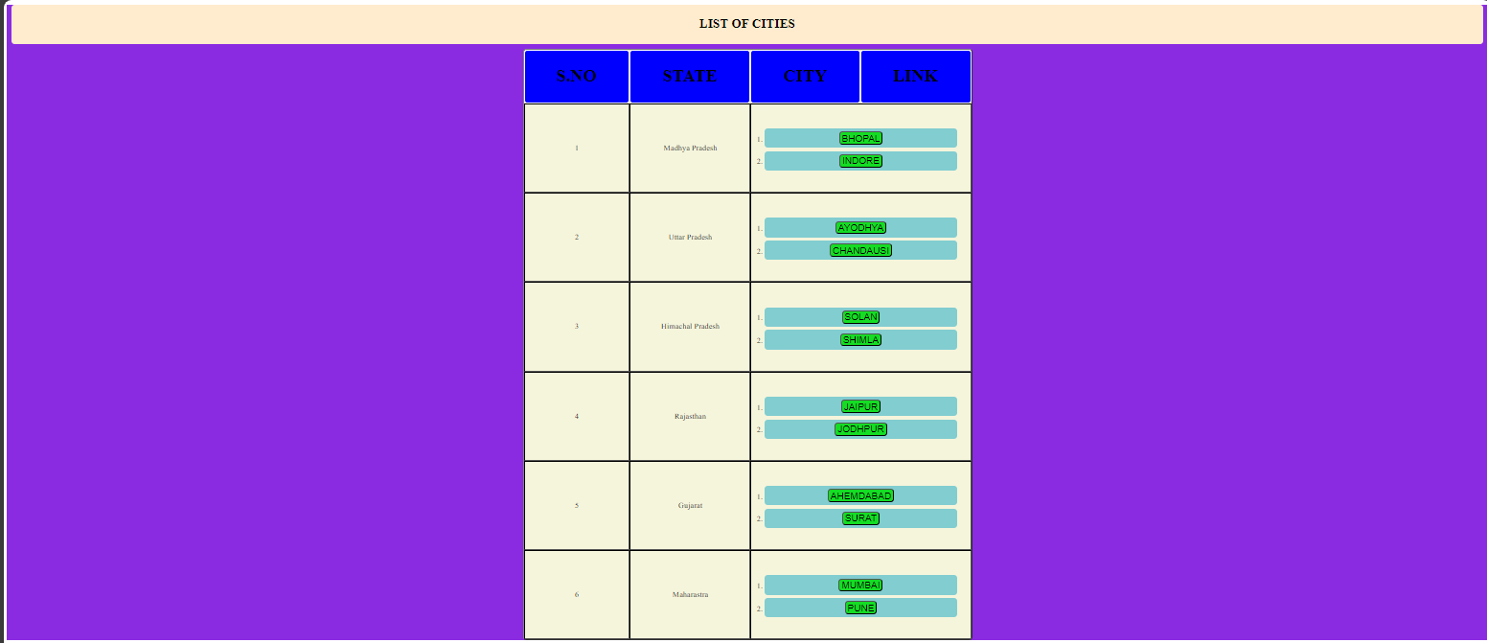

Slide 11
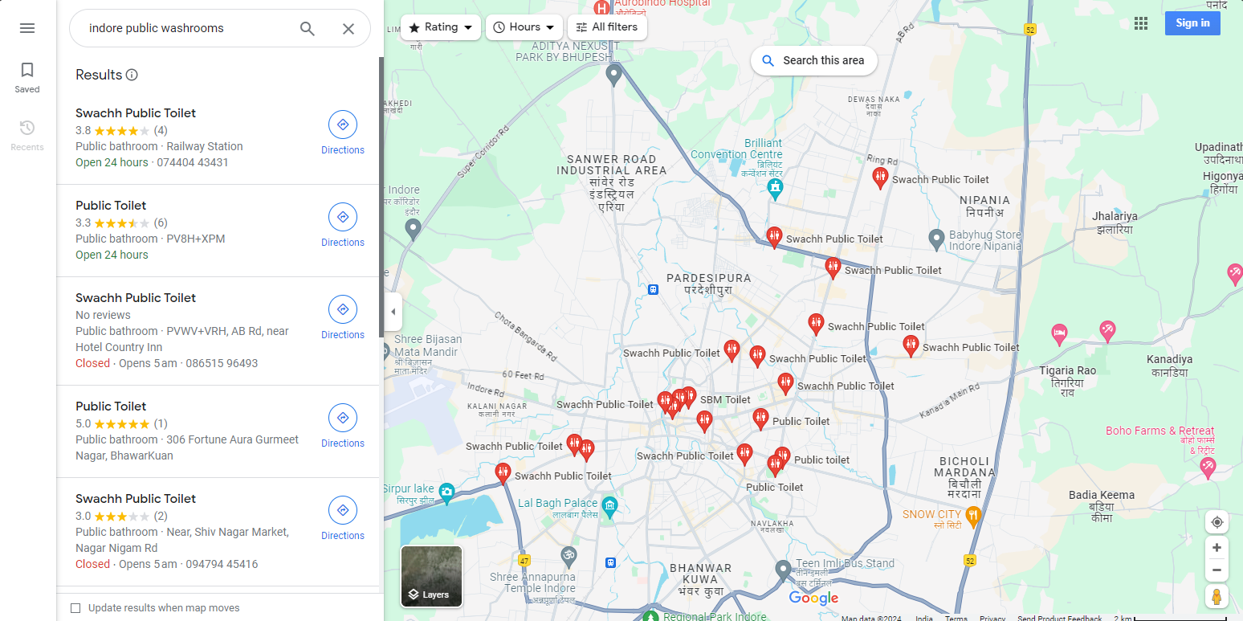
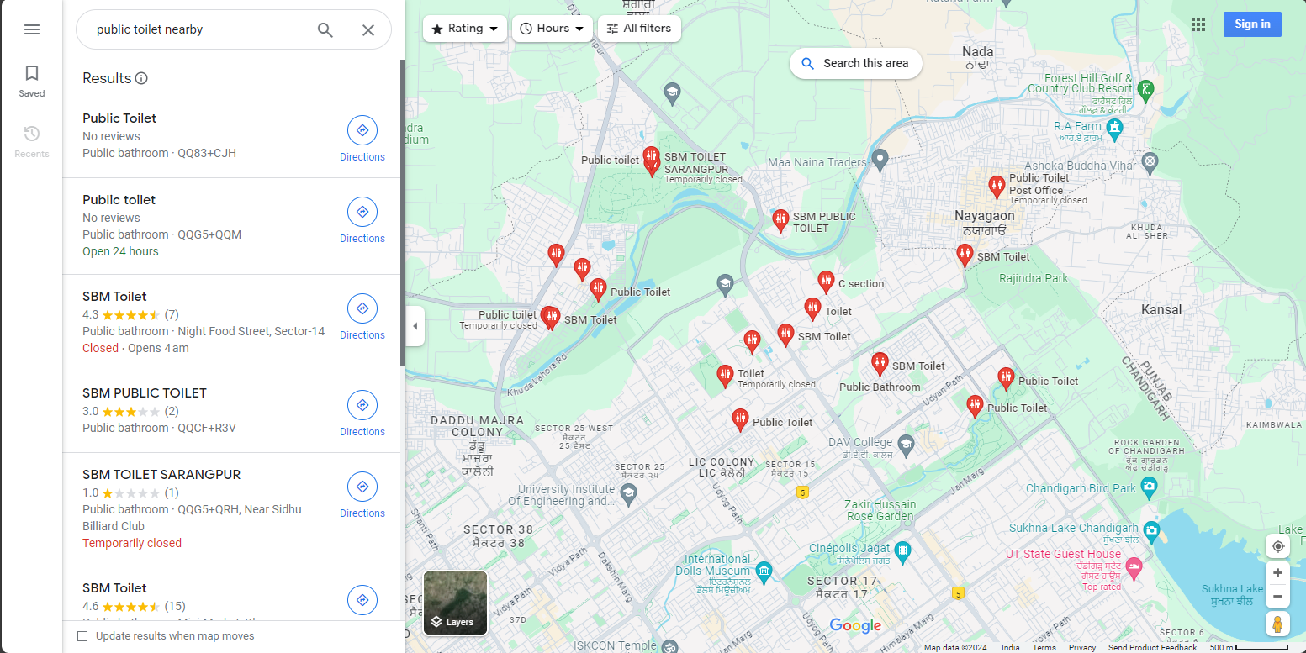
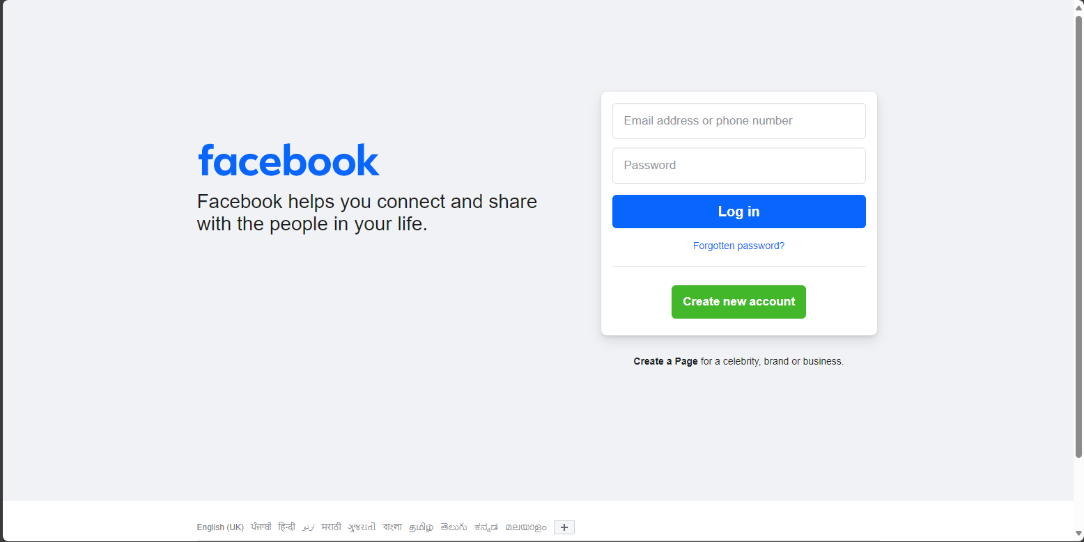

Slide 12
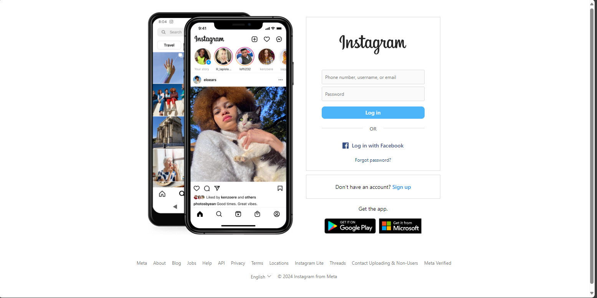

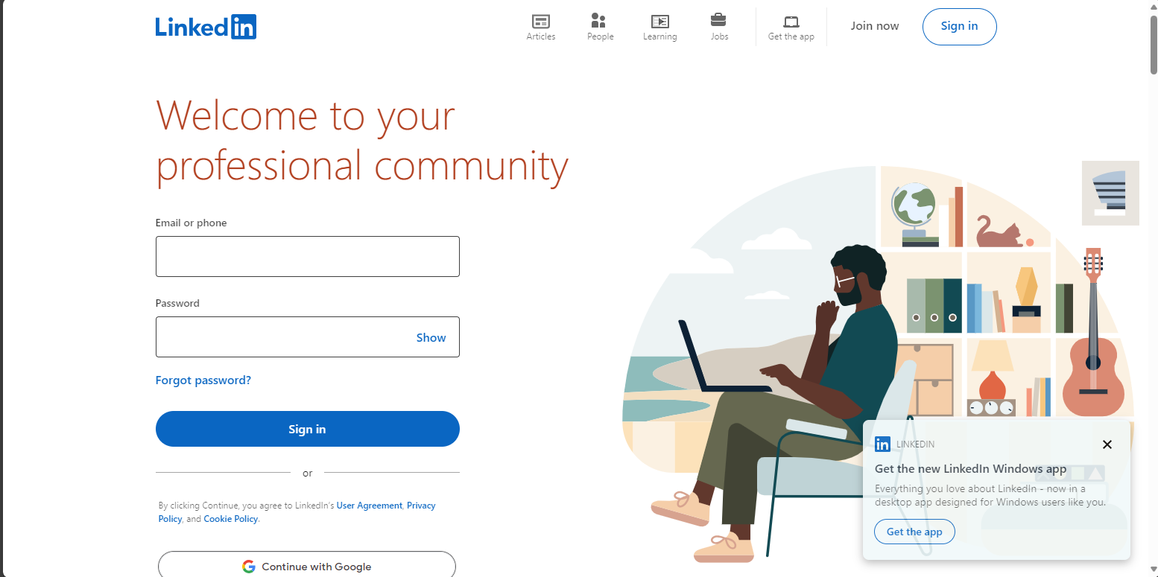
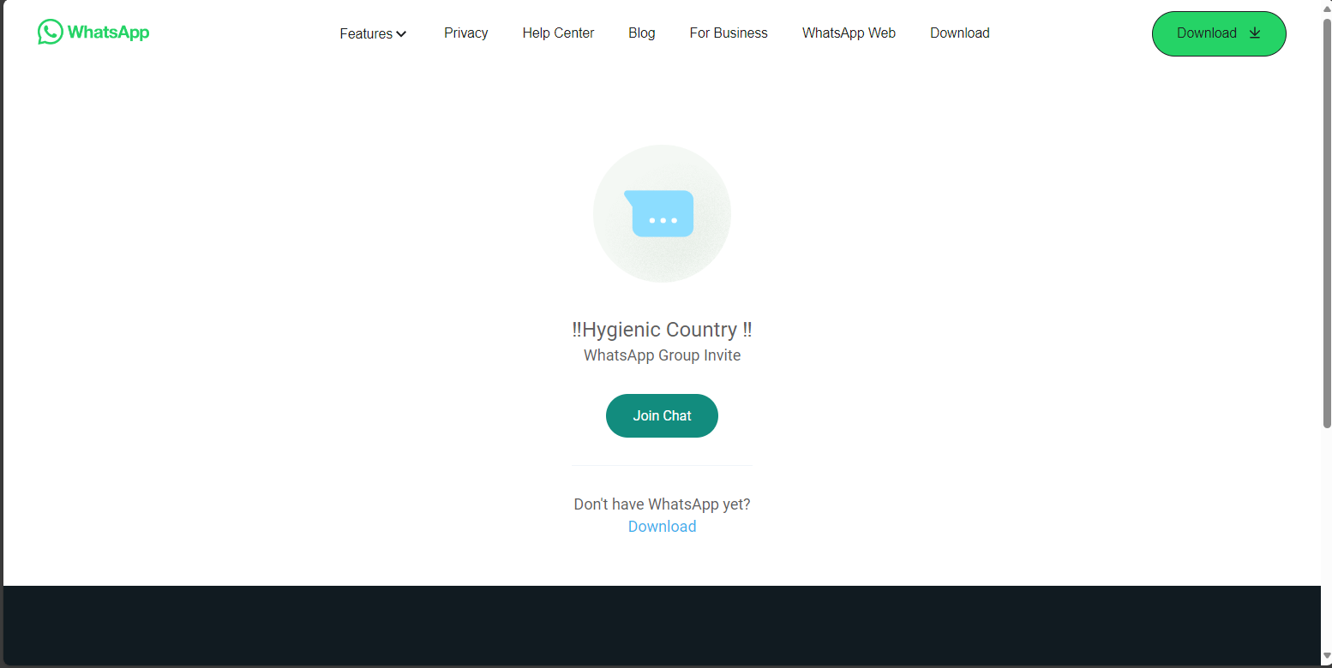

Slide 13
THANK YOU
TEAM MATES :
1. Gourav Berwal (Team Leader) [2330106]
2. Ansh Tomar [2330069]
3. Akarsh Sukhwal [2330057]
4. Abhishek Salaria [2330052]

